Slide 1
Lecture 10
Traditional Programming Models Compared to Android

Slide 2
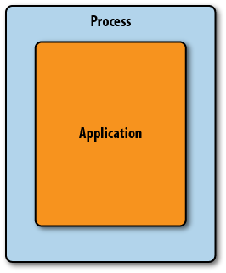
Traditional Programming Model
When start applications in traditional programming modal then it use a single entry point, often called Main.
Firstly, Main Function parse some command-line arguments.
Then proceed to execute a loop that would read user input and produce output.
The OS load the program code into a process and then start executing it.
This kind of process would look something like:-

Slide 3
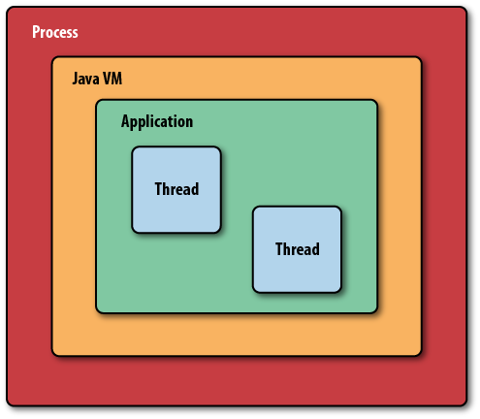
Traditional Programming Model
With programs written in Java, it gets a little more complex.
Java virtual machine(JVM) in a process loads byte-code to instantiate Java classes.
If you use a rich graphical user interface system like Swing, you might start a UI system and then write callbacks to your code that process events.
This process looks something like:-

Slide 4
Android Programming Model
Android introduces a richer and more complex approach.
Android supporting multiple application entry points.
Android programs should expect the system to start them in different places, depending on where the user is coming from and what he wants to do next.
Instead of a hierarchy of places, your program is a co-operating group of components that may be started from your application.
For example, a component to scan a bar code provides a function that many applications can integrate into their UI flow. Instead of relying on the user to directly start each application, the components themselves invoke one another to perform interactions.

Slide 5
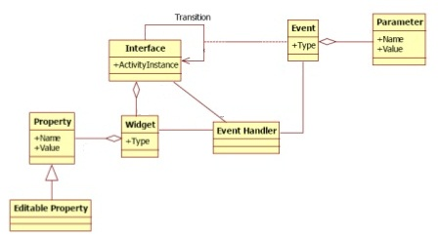
Android Programming Model
Graphical User Interface (GUI)- Programming Model:

Slide 6
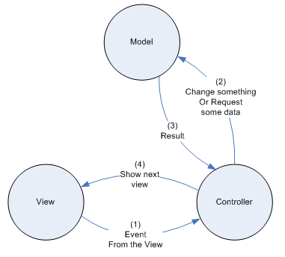
Android Programming Model
Model View Controller (MVC) Programming Model:

